Slide 1
Lecture 5c: FP Representations
To watch lecture video click link below
Lecture 5c video
To view slides, continue to next slide

Slide 2
Lecture 5c: Floating Point Representations

Slide 3
Floating-point (FP) Numbers
We need a way to represent
numbers with fractions, e.g., 3.1416159
pi
very small numbers, e.g., .000000001
Seconds in a nanosecond
very large numbers, e.g., 3.15576 × 10⁹
Seconds in a typical century
Representation
sign, exponent, significand/fraction
(–1)^{sign} × fraction x b^{exponent} (here b is the base.)
Examples
-9.8754 * 10⁴ (base 10)
1.1000000111000010 * 2⁻¹⁶ (base 2/binary)

Slide 4
Binary Representation
Common Representation
sign, exponent, fraction
(–1)^{sign} × fraction × 2^{exponent}
more bits for fraction gives more accuracy
more bits for exponent increases range
fraction also called significand/mantissa
Computer Representation
IEEE 754 Standard
Types of FP numbers
single precision: commonly refer to 32-bit representation
double precision: 64-bit representation

Slide 5
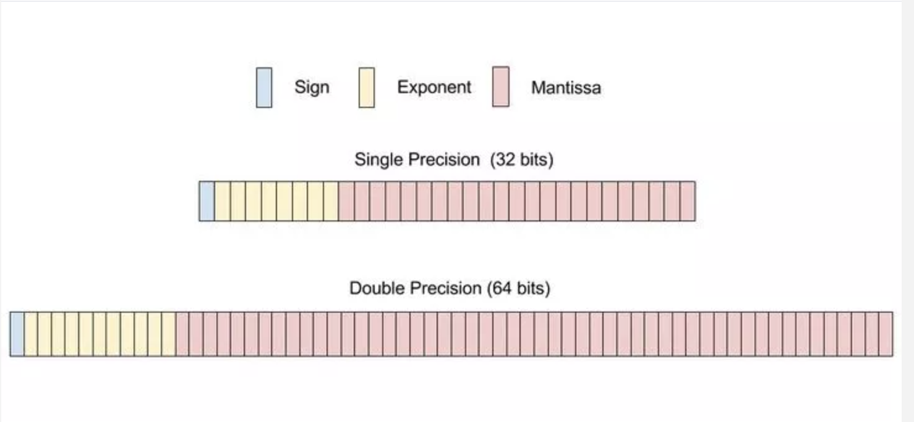
IEEE 754 FP Representations
(figure credit: wikihow.com)

Slide 6
IEEE 754 FP Single Precision
Single precision: 1 bit sign, 8 bits exponent, 23 bits fraction
Rule 1: sign bit: positive (0), negative (1)
Rule 2: Exponent “biased” representation
00000000 is the smallest exponent
11111111 is the largest exponent
bias is 127 (01111111), i.e.
01111111 represents exponent 0
less than 01111111 represents negative exponent
e.g. 01111110 represents -1 exponent
greater than 01111111 represents positive exponent
e.g. 10000001 represents +2 exponent
Sign (1 bit) | Exponent (8 bits) | Fraction (23 bits)

Slide 7
IEEE 754 FP Single Precision
Single precision: 1 bit sign, 8 bits exponent, 23 bits fraction
Rule 1: sign bit: positive (0), negative (1)
Rule 2: Exponent “biased” representation
Rule 3: Leading 1 is hidden
e.g. 1.1000000111000010
here the leftmost 1 will not be represented as part of fraction
because normalized numbers the leading 1 always 0
so it is “hidden”
extra caution should be taken when dealing with the hidden 1
Sign (1 bit) | Exponent (8 bits) | Fraction (23 bits)

Slide 8
Sign of FP number vs. Sign of Exponent
Look at the following two examples:
An FP number: + 1.1000000111000010 * 2⁻¹⁶
sign of the number is positive
sign of the exponent is negative
An FP number: - 1.1000000111000010 * 2⁺¹⁶
sign of the number is negative
sign of the exponent is positive

Slide 9
Example 1: + 1.1000000111000010 * 2⁻¹⁶
sign bit: 0 (positive)
exponent: 127 (bias) - 16 (actual exponent) or in binary
01111111 - 00010000 => 01101111
(01101111 < 01111111, it represents a negative exponent)
fraction: 1.1000000111000010 => 1000 0001 1100 0010 0000 000
(1) remove leading 1;
(2) fill up extra spaces at the end with 0s (safe to add extra 0 after decimal point.)
Final result: 0 01101111 1000 0001 1100 0010 0000 000
or written as follows (space between digits just for ease of reading)
0011 0111 1100 0000 1110 0001 0000 0000

Slide 10
Example 2: - 1.1000000111000010 * 2⁺¹⁶
sign bit: 1 (negative)
exponent: 127 (bias) + 16 (actual exponent) or in binary
01111111 + 00010000 => 10001111
fraction: 1.1000000111000010 => 1000 0001 1100 0010 0000 000
(same as Example 1)
Final result: 1 10001111 1000 0001 1100 0010 0000 000
or 1100 0111 1100 0000 1110 0001 0000 0000
Pause, practice it.

Slide 11
Example 3: Converting from Decimal to IEEE754
Representing –0.75 in IEEE 754 standard
decimal: -.75 = -3/4 = -3/2²
binary: -.11 = -1.1 x 2⁻¹
IEEE 754 single precision
Sign: 1 (negative)
exponent = 127+(-1) = 126 = 01111110
Fraction: 1.1 with leading 1 removed and 0s added 100…0
fraction
Final result: 10111111010000000000000000000000

Slide 12
Special Representations
How to represent 1.0 in 32-bit single precision?
0 01111111 000 …0 (that is, 1.0 = 1.0 * 2^0)
How to represent 0.0?
0 00000000 000…0 (this is a special representation.)
Other special representation (for single precision)
Exp Fraction Number Represented
0 0 0.0
0 non-zero denormalized number
1-254 anything legal FP number
255 0 infinity
255 non-zero NaN (not a number)

Slide 13
Special Representations: what we need to know
Identify the following representation? i.e. what FP number does each of the following represent?
0 00000000 00000000000000000000000
1 00000000 00000000000000000000000
0 11111111 00000000000000000000000
1 11111111 00000000000000000000000

Slide 14
Special Representations: what we need to know
Identify the following representation? i.e. what FP number does each of the following represent?
0 00000000 00000000000000000000000 (+0.0/0.0)
1 00000000 00000000000000000000000 (-0.0)
0 11111111 00000000000000000000000 (+∞)
1 11111111 00000000000000000000000 (-∞)

Slide 15
FP Representation: Interpretation
Assume the following bit pattern represents an FP number in IEEE 754 format, please find the number represented.
e.g. 1 10000001 11000000000000000000000 represents
sign: 1 (negative); exponent 10000001 => 129
fraction: 1.1100…0 (hidden 1 added back)
-1.11₂ * 2 ⁽¹²⁹⁻¹²⁷⁾ = -1.75*2² (okay to leave the result in this format)
= -7.0
Please work out the following:
0 01111101 10100000000000000000000
1100 0110 0011 1000 0000 0000 0000 0000
Pause. Practice!

Slide 16
FP Representation: Interpretation
Assume the following bit pattern represents an FP number in IEEE 754 format, please find the number represented.
e.g. 1 10000001 11000000000000000000000 represents
sign: 1 (negative); exponent 10000001 => 129
fraction: 1.1100…0 (hidden 1 added back)
-1.11₂ * 2 ⁽¹²⁹⁻¹²⁷⁾ = -1.75*2² (okay to leave the result in this format)
= -7.0
Please work out the following:
0 01111101 10100000000000000000000 (1.625 * 2⁻²)
1100 0110 0011 1000 0000 0000 0000 0000 (-1.4375*2¹³)

Slide 17
Double Precision
Double precision representation
1 bit sign, 11 bit exponent, 52 bit fraction
Bias is 1023 (i.e. 01111111111)
Example:
decimal: -.75 = -3/4 = -3/2²
binary: -.11 = -1.1 x 2⁻¹
IEEE 754 double precision:
sign bit: 1
exponent: 1023 + (-1) = 1022 = 01111111110
fraction: 1000 …..000 (total 52 bits)
1 01111111110 1000 0000 0000 0000 0000 0000 0000 0000 0000 0000 0000 0000 0000

Slide 18
Thinking Questions
What is the most/largest positive FP number that can be represented in IEEE 754 single precision? Double precision?
What about the most negative FP number?
What is the positive smallest FP number (i.e. the number most close to 0.0 but not equal 0.0) that can be represented in IEEE 754 single precision? Double precision?

Slide 19
Bit Patterns
Bit patterns don’t have inherent meanings.
Given a 32-bit pattern,
1010 0110 0011 0010 0011 0000 0000 1000
What does it represent if we know it is a
(1) unsigned integer number?
(2) two’s complement integer number?
(3) A MIPS instruction?
(4) A FP number in IEEE 754 representation?

Slide 20
1010 1110 0011 0010 0011 0000 0000 1000
Unsigned integer
2³¹+2²⁹+2²⁷+ 2²⁶+2²⁵+ 2²¹ + 2²⁰+ 2¹⁷+2¹³ +2¹² + 2³ =2,922,524,680
(2) Two’s complement
a negative number, absolute value: 0101 0001 1100 1101 1100 1111 1111 1000
-(2³⁰+2²⁸+2²⁴+2²³+2²²+2¹⁹+2¹⁸ +2¹⁶ +2¹⁵+2¹⁴+2¹¹ +2¹⁰+2⁹+2⁸ +2⁷+2⁶+2⁵ +2⁴+2³ )= -1,372,442,616
(3) MIPS instruction
opcode 101011 => 0x2b => sw instruction => I type
101011 10001 10010 0011 0000 0000 1000
sw R17 R18 0x3008 => sw R18, 0x3008(R17)
(4) FP number (single precision)
sign: 1 (negative), exponent: 01011100 => 92 => 92-127 = -35
fraction: 0110 0100 0110 0000 0001 000 => 1.01100100011000000001000
=> 1+(2⁻²+2⁻³+2⁻⁶+2⁻¹⁰+2⁻¹¹+2⁻²⁰) = 1.391602516174316
- 1.391602516174316 x 2⁻³⁵ (no need to further simplify.)

Slide 21
Limitation: Precision and Accuracy
Computer arithmetic is constrained by limited precision
Limited by the number of bits in the fraction part;
Thus, FP representations are mostly approximations
Double precision has better accuracy
Uses 52 bits for fraction, compare with 23 bits in single precision
Accuracy is important!
There are many complexities in real machines
data types in programming languages
“float” (single precision) and “double” (double precision)
Newer programming languages may only use “double”

Slide 22
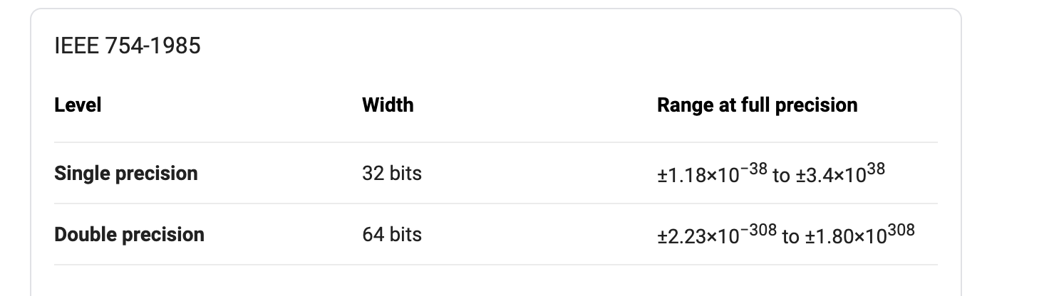
Limitation: Range of Values
Only a limited range of FP values can be represented
Limited by the number of bits in exponent part
8 bits for single precision, 11 bits for double prevision.
Figure credit: wikipedia.org

Slide 23
Overflow and Underflow
Overflow (floating-point): A situation in which a positive exponent becomes too large to fit in the exponent field.
Underflow (floating-point): A situation in which a negative exponent becomes too large to fit in the exponent field.
Details to be discussed in FP addition/multiplication.

Slide 24
Summary
IEEE 754 FP representations
Single precision (32-bit), double precision (64-bit)
Including special representations
We covered in details
Converting a FP number to IEEE 754 single precision
Converting back a 32-bit pattern in IEEE 754 to a FP number
A 32-bit pattern could be interpreted in many different ways
Unsigned numbers, two’s complement, MIPS instruction, FP number
We brought up the concepts but didn’t cover in-depth
Converting FP numbers to IEEE 754 double precision
Discussion on precision, accuracy, and range.

Slide 25
To-Do List
zyBook 3.5 (up to Floating Point Addition)
HW #3
May do the problems already covered in the lecture
Piazza participation:
Thinking questions, or
Any of other topics related to the course

